Slide 1
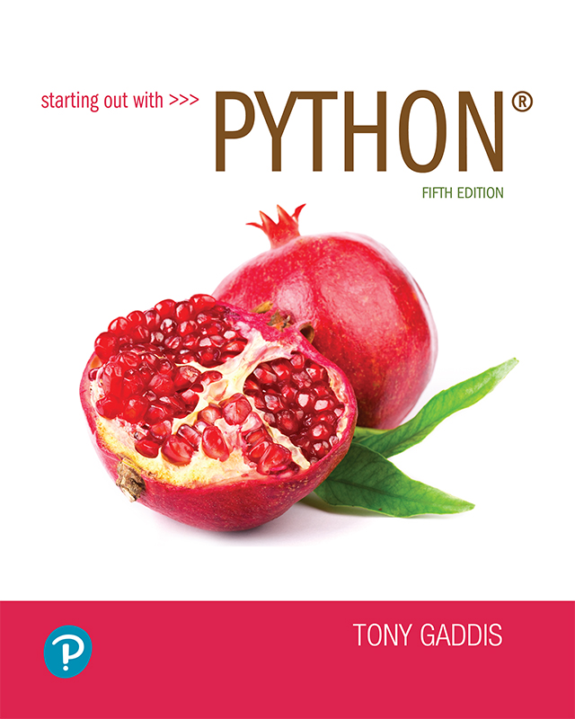
Starting out with Python
Fifth Edition
Chapter 8
More About Strings
Copyright © 2021, 2018, 2015 Pearson Education, Inc. All Rights Reserved

Slide 2
Topics
Basic String Operations
String Slicing
Testing, Searching, and Manipulating Strings

Slide 3
Basic String Operations
Many types of programs perform operations on strings (word processing, emails, search engines, etc.)
In Python, many tools for examining and manipulating strings
Strings are sequences, so many of the tools that work with sequences work with strings

Slide 4
Accessing the Individual Characters in a String (1 of 4)
To access an individual character in a string:
Use a for loop
Format: for character in string:
Useful when need to iterate over the whole string, such as to count the occurrences of a specific character
Use indexing
Each character has an index specifying its position in the string, starting at 0
Format: character = my_string[i]

Slide 5
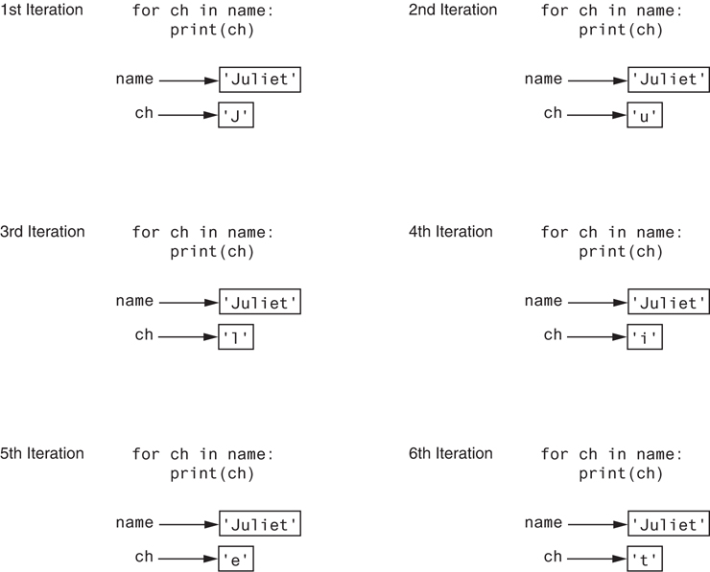
Accessing the Individual Characters in a String (2 of 4)
Figure 8-1 Iterating over the string 'Juliet'

Slide 6


Accessing the Individual Characters in a String (3 of 4)
Figure 8-2 String indexes
Can use positive / Negative Index
Ch[6]
Figure 8-3 Getting a copy of a character from a string

Slide 7
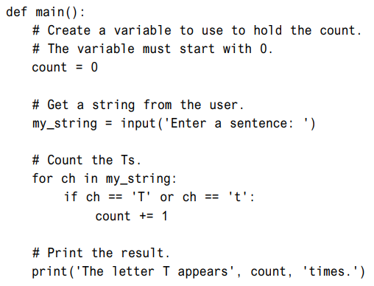

Slide 8
Accessing the Individual Characters in a String (4 of 4)
IndexError exception will occur if:
You try to use an index that is out of range for the string
Likely to happen when loop iterates beyond the end of the string
len(string) function can be used to obtain the length of a string
Useful to prevent loops from iterating beyond the end of a string

Slide 9
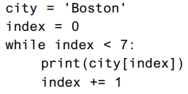
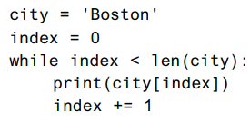
Accessing the Individual Characters in a String (cont’d.)

Slide 10

String Concatenation
Concatenation: appending one string to the end of another string
Use the + operator to produce a string that is a combination of its operands
The augmented assignment operator += can also be used to concatenate strings
The operand on the left side of the += operator must be an existing variable; otherwise, an exception is raised

Slide 11
Strings Are Immutable (1 of 2)
Strings are immutable
Once they are created, they cannot be changed
Concatenation doesn’t actually change the existing string, but rather creates a new string and assigns the new string to the previously used variable
Cannot use an expression of the form
string[index] = new_character
Statement of this type will raise an exception

Slide 12

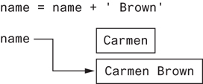
Strings Are Immutable (2 of 2)
Figure 8-4 The string ‘Carmen’ assigned to name
Figure 8-5 The string ‘Carmen Brown’ assigned to name

Slide 13

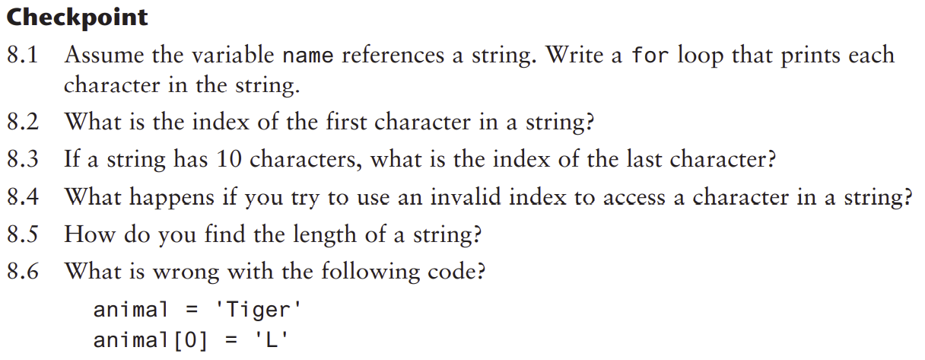
Test your understanding

Slide 14
String Slicing
Slice: span of items taken from a sequence, known as substring
Slicing format: string[start : end]
Expression will return a string containing a copy of the characters from start up to, but not including, end
If start not specified, 0 is used for start index
If end not specified, len(string) is used for end index
Slicing expressions can include a step value and negative indexes relative to end of string

Slide 15
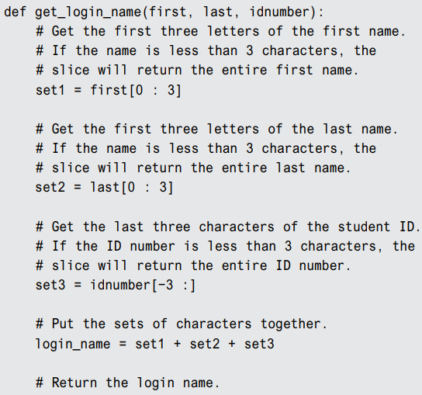
Extracting Characters from a String

Slide 16
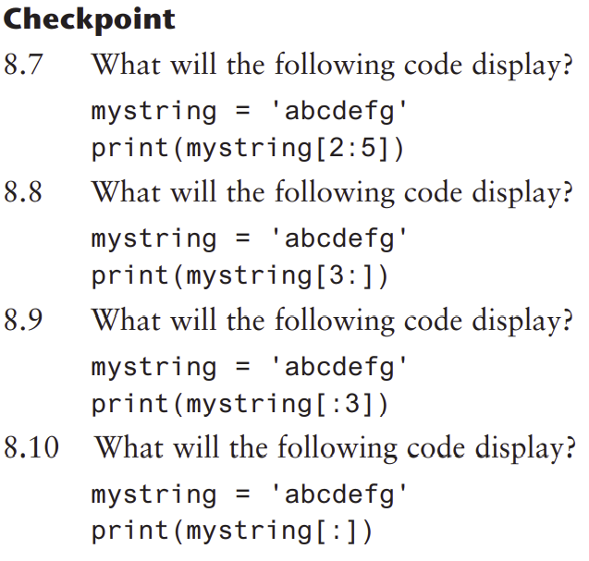
Test your understanding

Slide 17
Testing, Searching, and Manipulating Strings
You can use the in operator to determine whether one string is contained in another string
General format: string1 in string2
string1 and string2 can be string literals or variables referencing strings
Similarly you can use the not in operator to determine whether one string is not contained in another string

Slide 18
String Methods (1 of 7)
Strings in Python have many types of methods, divided into different types of operations
General format: mystring.method(arguments)
Some methods test a string for specific characteristics
Generally Boolean methods, that return True if a condition exists, and False otherwise

Slide 19
String Methods (2 of 7)
Table 8-1 Some string testing methods
Method | Description
isalnum() | Returns true if the string contains only alphabetic letters or digits and is at least one character in length. Returns false otherwise.
isalpha() | Returns true if the string contains only alphabetic letters and is at least one character in length. Returns false otherwise.
isdigit() | Returns true if the string contains only numeric digits and is at least one character in length. Returns false otherwise.
islower() | Returns true if all of the alphabetic letters in the string are lowercase, and the string contains at least one alphabetic letter. Returns false otherwise.
isspace() | Returns true if the string contains only whitespace characters and is at least one character in length. Returns false otherwise. (Whitespace characters are spaces, newlines (\n), and tabs (\t).
isupper() | Returns true if all of the alphabetic letters in the string are uppercase, and the string contains at least one alphabetic letter. Returns false otherwise.

Slide 20
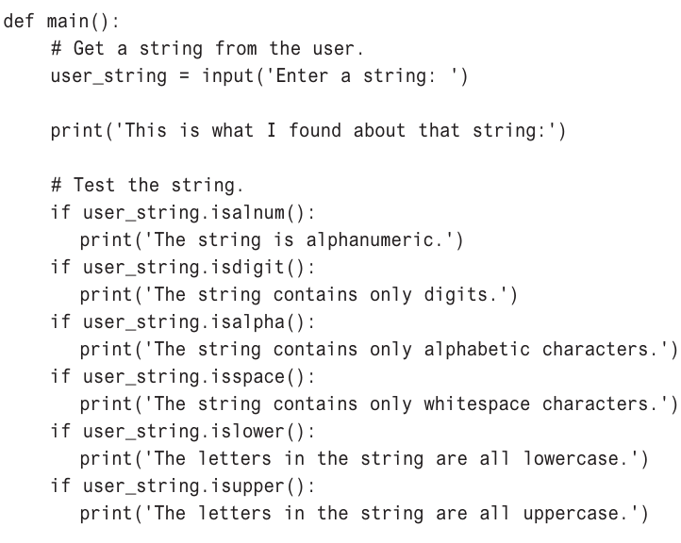

Slide 21
String Methods (3 of 7)
Some methods return a copy of the string, to which modifications have been made
Simulate strings as mutable objects
String comparisons are case-sensitive
Uppercase characters are distinguished from lowercase characters
lower and upper methods can be used for making case-insensitive string comparisons

Slide 22
String Methods (4 of 7)
Table 8-2 String Modification Methods
Method | Description
lower() | Returns a copy of the string with all alphabetic letters converted to lowercase. Any character that is already lowercase, or is not an alphabetic letter, is unchanged.
lstrip() | Returns a copy of the string with all leading whitespace characters removed. Leading whitespace characters are spaces, newlines (\n), and tabs (\t) that appear at the beginning of the string.
lstrip(char) | The char argument is a string containing a character. Returns a copy of the string with all instances of char that appear at the beginning of the string removed.
rstrip() | Returns a copy of the string with all trailing whitespace characters removed. Trailing whitespace characters are spaces, newlines (\n), and tabs (\t) that appear at the end of the string.
rstrip(char) | The char argument is a string containing a character. The method returns a copy of the string with all instances of char that appear at the end of the string removed.
strip() | Returns a copy of the string with all leading and trailing whitespace characters removed.
strip(char) | Returns a copy of the string with all instances of char that appear at the beginning and the end of the string removed.
upper() | Returns a copy of the string with all alphabetic letters converted to uppercase. Any character that is already uppercase, or is not an alphabetic letter, is unchanged.

Slide 23
String Methods (5 of 7)
Programs commonly need to search for substrings
Several methods to accomplish this:
endswith(substring): checks if the string ends with substring
Returns True or False
startswith(substring): checks if the string starts with substring
Returns True or False

Slide 24
String Methods (6 of 7)
Several methods to accomplish this (cont’d):
find(substring): searches for substring within the string
Returns lowest index of the substring, or if the substring is not contained in the string, returns -1
replace(substring, new_string):
Returns a copy of the string where every occurrence of substring is replaced with new_string

Slide 25
String Methods (7 of 7)
Table 8-3 Search and replace methods
Method | Description
endswith(substring) | The substring argument is a string. The method returns true if the string ends with substring.
find(substring) | The substring argument is a string. The method returns the lowest index in the string where substring is found. If substring is not found, the method returns −1.
replace(old, new) | The old and new arguments are both strings. The method returns a copy of the string with all instances of old replaced by new.
startswith(substring) | The substring argument is a string. The method returns true if the string starts with substring.

Slide 26
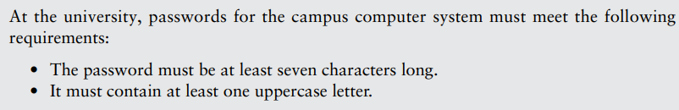

Spotlight: Password Validator

Slide 27
The Repetition Operator
Repetition operator: makes multiple copies of a string and joins them together
The * symbol is a repetition operator when applied to a string and an integer
String is left operand; number is right
General format: string_to_copy * n
Variable references a new string which contains multiple copies of the original string

Slide 28
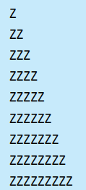

The Repetition Operator

Slide 29
Splitting a String (1 of 2)
split method: returns a list containing the words in the string
By default, uses space as separator
Can specify a different separator by passing it as an argument to the split method

Slide 30
Splitting a String (2 of 2)
Examples:
>>> my_string = 'One two three four'
>>> word_list = my_string.split()
>>> word_list
['One', 'two', 'three', 'four']
>>>
>>> my_string = '1/2/3/4/5'
>>> number_list = my_string.split('/')
>>> number_list
['1', '2', '3', '4', '5']
>>>

Slide 31
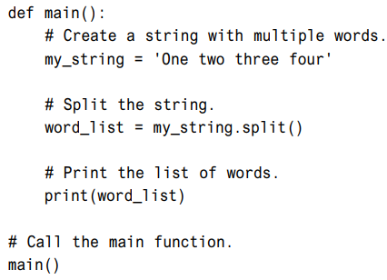
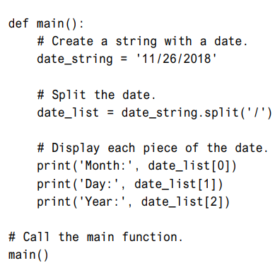
Splitting a String

Slide 32
Summary
This chapter covered:
String operations, including:
Methods for iterating over strings
Repetition and concatenation operators
Strings as immutable objects
Slicing strings and testing strings
String methods
Splitting a string

